Slide 1


Xing Wei, Chan
29th July 2022

Slide 2

Outline
Executive Summary
Introduction
Methodology
Results
Conclusion
Appendix

Slide 3
Executive Summary
Summary of methodologies
Gather Data from the following sources:
SpaceX API
Wikipedia
Parse data into suitable formats and data structure
Perform Exploratory Data Analysis
Perform Interactive Analytics
Fit data into various classification models
Determine the best model to predict if the first stage will land
Apply the built model into prediction of future rocket launches
Summary of all results
KSC LC-39A has the highest success rate out of all launch sites
FT Booster has highest successful launch rate
All 4 classification models performs almost equally well while Decision Tree performs slightly better

Slide 4
Introduction
Project background and context
SpaceX is an American spacecraft manufacturer, space launch provider, and a satellite communications corporation.
SpaceX’s accomplishments include: Sending spacecraft to the International Space Station. Starlink, a satellite internet constellation providing satellite Internet access. Sending manned missions to Space.
Much of the savings behind SpaceX’s cheap rocket launch is because SpaceX can reuse the first stage.
SpaceY would like to compete with SpaceX.
Problems you want to find answers
Main goal is to build a machine learning model to predict whether the first stage will land successfully, which is one of the biggest determinant on the cost of the rocket launch.

Slide 5

Section 1

Slide 6
Methodology
Executive Summary
Data collection methodology
A portion of data are collected from requesting from SpaceX API and stored as a dataframe
The rest of the data are scraped from SpaceX Past Launch Record (Wikipedia) and stored as a dataframe
Perform data wrangling
Filter to only ‘Falcon 9’ booster version
Replace all NULL values from the Payload Mass with the average value
Create ‘Class’ column from ‘Landing Outcome’ column to change all different outcomes to 0 (Failed) or 1 (Successful)
Perform exploratory data analysis (EDA) using visualization and SQL

Slide 7
Methodology
Executive Summary
Perform interactive visual analytics using Folium and Plotly Dash
Perform predictive analysis using classification models
Using StandardScaler to normalize the train dataset X
The train dataset Y is the ‘Class’ column of the dataframe
X and Y are split into 80% train dataset and 20% test dataset with train_test_split()
4 classification models are tested (Linear Regression, Decision Tree, Support Vector Machines, K-Nearest Neighbors4)
Use GridSearchCV to test all relevant parameters to find the best parameters for each of the model
Using the accuracy scoring and confusion matrix to determine which model performs the best in predicting whether the first stage of a rocket launch will land successfully

Slide 8
Data Collection
Collection of datasets
'rocket', 'payloads', 'launchpad', 'cores', 'flight_number', 'date_utc’ are collected from the calling SpaceX API (https://api.spacexdata.com/v4/...) and stored as a dataframe A
‘Flight No.’, ‘Launch site’, ‘Payload’, ‘Payload mass’, ‘Orbit’, ‘Customer’, ‘Launch outcome’, ‘Version Booster’, ‘Booster landing’ are scraped from Wikipedia (Here) and stored as a dataframe B
You need to present your data collection process use key phrases and flowcharts
Sources
Action
Raw Dataset
SpaceX API
Request API
Dataframe A
Wikipedia
Scaping
Dataframe B

Slide 9
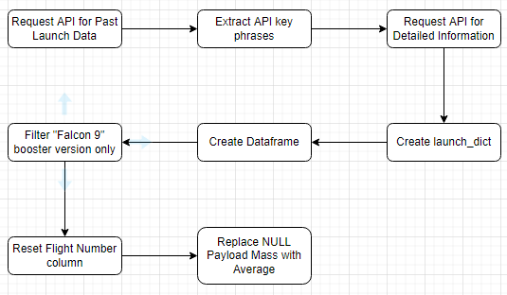
Data Collection – SpaceX API
Request past launch data from SpaceX API
Extract Key phrases from past launch data
Request SpaceX API for detailed information of all key phrases collected
Create launch_dict dictionary to contain all useful data
Create a dataframe from the launch_dict
Filter dataframe to contain “Falcon 9” booster version only
Reset the “Flight Number” column
Replace the NULL value from “Payload Mass” column with the mean value
Jupyter Notebook (Github):https://github.com/pi31416chan/Coursera-Applied-Data-Science-Capstone/blob/07e61d917346674b1d013b39d6612eda41309e1b/1.%20Data%20Collection%20API.ipynb

Slide 10
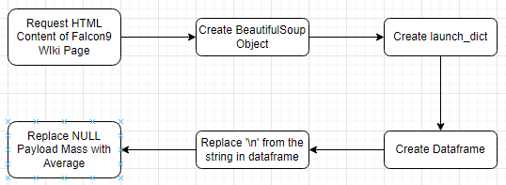
Data Collection - Scraping
Request HTML content from Falcon 9 Wikipedia page
Create BeautifulSoup object from the HTML content
Extract the table containing required information from the BeautifulSoup object
Create launch_dict dictionary
Create a dataframe from the launch_dict
Replace ‘\n’ from the strings in the dataframe
Replace the NULL value from “Payload Mass” column with the mean value
Jupyter Notebook (Github): https://github.com/pi31416chan/Coursera-Applied-Data-Science-Capstone/blob/07e61d917346674b1d013b39d6612eda41309e1b/2.%20Data%20Collection%20with%20Web%20Scraping.ipynb

Slide 11
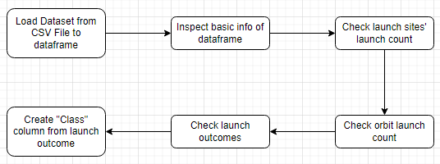
Data Wrangling
Load previously collected dataset from CSV file into dataframe
Inspect basic information of the dataframe (dtypes, describe(), shape, …)
Check launch count of different launch sites
Check launch count of different orbits
Check launch outcomes
Create “Class” column from launch outcome to convert launch outcome from text to 0 (Failure) or 1 (Successful)
Jupyter Notebook (Github): https://github.com/pi31416chan/Coursera-Applied-Data-Science-Capstone/blob/07e61d917346674b1d013b39d6612eda41309e1b/3.%20Data%20wrangling.ipynb

Slide 12
EDA with Data Visualization
Scatter Plot of Flight Number vs Payload Mass (hue = ‘Class’)
To see how the successful rate (Class) changes with Flight Number or Payload Mass
Scatter Plot of Flight Number vs Launch Site (hue = ‘Class’)
To visualize the relationship between Flight Number, Launch Site and Class
Scatter Plot of Payload Mass vs Launch Site (hue = ‘Class’)
To visualize the relationship between Payload Mass, Launch Site and Class
Bar Chart for the sucess rate of each orbit
To visualize the relationship between success rate of each orbit type
Scatter Plot of Flight Number vs Orbit Type (hue = ‘Class’)
To visualize the relationship between FlightNumber and Orbit type
Scatter Plot of Payload Mass vs Orbit Type (hue = ‘Class’)
To visualize the relationship between Payload Mass and Orbit type
Line Chart of Year vs Success Rate
To visualize the launch success yearly trend
Jupyter Notebook (Github): https://github.com/pi31416chan/Coursera-Applied-Data-Science-Capstone/blob/07e61d917346674b1d013b39d6612eda41309e1b/5.%20Exploratory%20Data%20Analysis%20with%20Data%20Visualization.ipynb

Slide 13
EDA with SQL
SELECT DISTINCT(Launch_Site) FROM spacex_capstone.spacextbl;
SELECT Launch_Site FROM spacex_capstone.spacextbl WHERE Launch_Site LIKE "CCA%" LIMIT 5;
SELECT SUM(PAYLOAD_MASS__KG_) FROM spacex_capstone.spacextbl WHERE Customer = "NASA (CRS)";
SELECT AVG(PAYLOAD_MASS__KG_) FROM spacex_capstone.spacextbl WHERE Booster_Version = "F9 v1.1";
SELECT MIN(`Date`),Landing_Outcome FROM spacex_capstone.spacextbl WHERE Landing_Outcome = "Success (ground pad)";
SELECT Booster_Version FROM spacex_capstone.spacextbl WHERE Landing_Outcome = 'Success (drone ship)' AND PAYLOAD_MASS__KG_ BETWEEN 4000 AND 6000;
SELECT Mission_Outcome,COUNT(Mission_Outcome) FROM spacex_capstone.spacextbl GROUP BY Mission_Outcome;
SELECT Booster_Version,PAYLOAD_MASS__KG_ FROM spacex_capstone.spacextbl WHERE PAYLOAD_MASS__KG_ = (SELECT MAX(PAYLOAD_MASS__KG_) FROM spacex_capstone.spacextbl);
SELECT Landing_Outcome,Booster_Version,Launch_Site FROM spacex_capstone.spacextbl WHERE Landing_Outcome LIKE "%drone%" AND Landing_Outcome LIKE "%Fail%" AND YEAR(`Date`) = 2015;
SELECT Landing_Outcome,COUNT(Landing_Outcome) FROM spacex_capstone.spacextbl WHERE `Date` BETWEEN '2010-06-04' AND '2017-03-20’ GROUP BY Landing_Outcome ORDER BY COUNT(Landing_Outcome) DESC;
Jupyter Notebook (Github): https://github.com/pi31416chan/Coursera-Applied-Data-Science-Capstone/blob/07e61d917346674b1d013b39d6612eda41309e1b/4.%20Exploratory%20Data%20Analysis%20with%20SQL.ipynb

Slide 14
Build an Interactive Map with Folium
Circle
To highlight the area of NASA headquarter & multiple launch sites
Marker
To mark the coordinate of each rocket launch
MarkerCluster
To hold nearby markers into a cluster
Icon
To illustrate the launch outcome of each rocket launch with color
MousePosition
To get the coordinate where the mouse pointer points at in the map
Line
To illustrate the distance from the nearest public objects (City, Highway, Railway)
Jupyter Notebook (Github): https://github.com/pi31416chan/Coursera-Applied-Data-Science-Capstone/blob/07e61d917346674b1d013b39d6612eda41309e1b/6.%20Interactive%20Visual%20Analytics%20with%20Folium.ipynb

Slide 15
Build a Dashboard with Plotly Dash
Interactions:
Dropdown List
To select the Launch Site
Range Slider Bar
To select the range of Payload Mass
Charts:
Pie Chart
To visualize the Success Rate of different launch sites
Scatter Plot
To visualize the Payload Mass, Success Rate and Booster Version
Jupyter Notebook (Github): https://github.com/pi31416chan/Coursera-Applied-Data-Science-Capstone/blob/07e61d917346674b1d013b39d6612eda41309e1b/7.%20Interactive%20Dashboard.ipynb
Source Code (Python): https://github.com/pi31416chan/Coursera-Applied-Data-Science-Capstone/blob/07e61d917346674b1d013b39d6612eda41309e1b/7.%20Interactive%20Dashboard.py

Slide 16
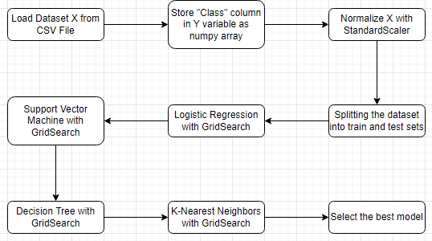
Predictive Analysis (Classification)
Load dataset from CSV file as X
Store the “Class” column into Y as a numpy array
Normalize data of X with StandardScaler
Split the dataset into train (80%) and test (20%) datasets
Use GridSearchCV to get best parameters for Logistic Regression, plot confusion matrix
Use GridSearchCV to get best parameters for Support Vector Machine , plot confusion matrix
Use GridSearchCV to get best parameters for Decision Tree , plot confusion matrix
Use GridSearchCV to get best parameters for K-Nearest Neighbors , plot confusion matrix
Use accuracy score and confusion matrix to select the best classification model
Jupyter Notebook (Github): https://github.com/pi31416chan/Coursera-Applied-Data-Science-Capstone/blob/07e61d917346674b1d013b39d6612eda41309e1b/8.%20Machine%20Learning%20Prediction.ipynb (Ignore the long auto-generated warning due to some features are deprecated and scroll to the bottom, thanks)

Slide 17
Results (EDA)
Only 4 launch sites are involved
CCAFS LC-40, CCAFS SLC-40, KSC LC-39A, VAFB SLC-4E
KSC LC-39A site has largest successful launch number & highest successful launch rate
100% success rate at payload <= 5000 and very high success rate at payload > 8000
Success Rate of heavier Payload appears to be higher
SSO orbit type has 100% success rate
VLEO orbit type has very high success rate (~87%)
Success Rate has been increasing since 2013

Slide 18
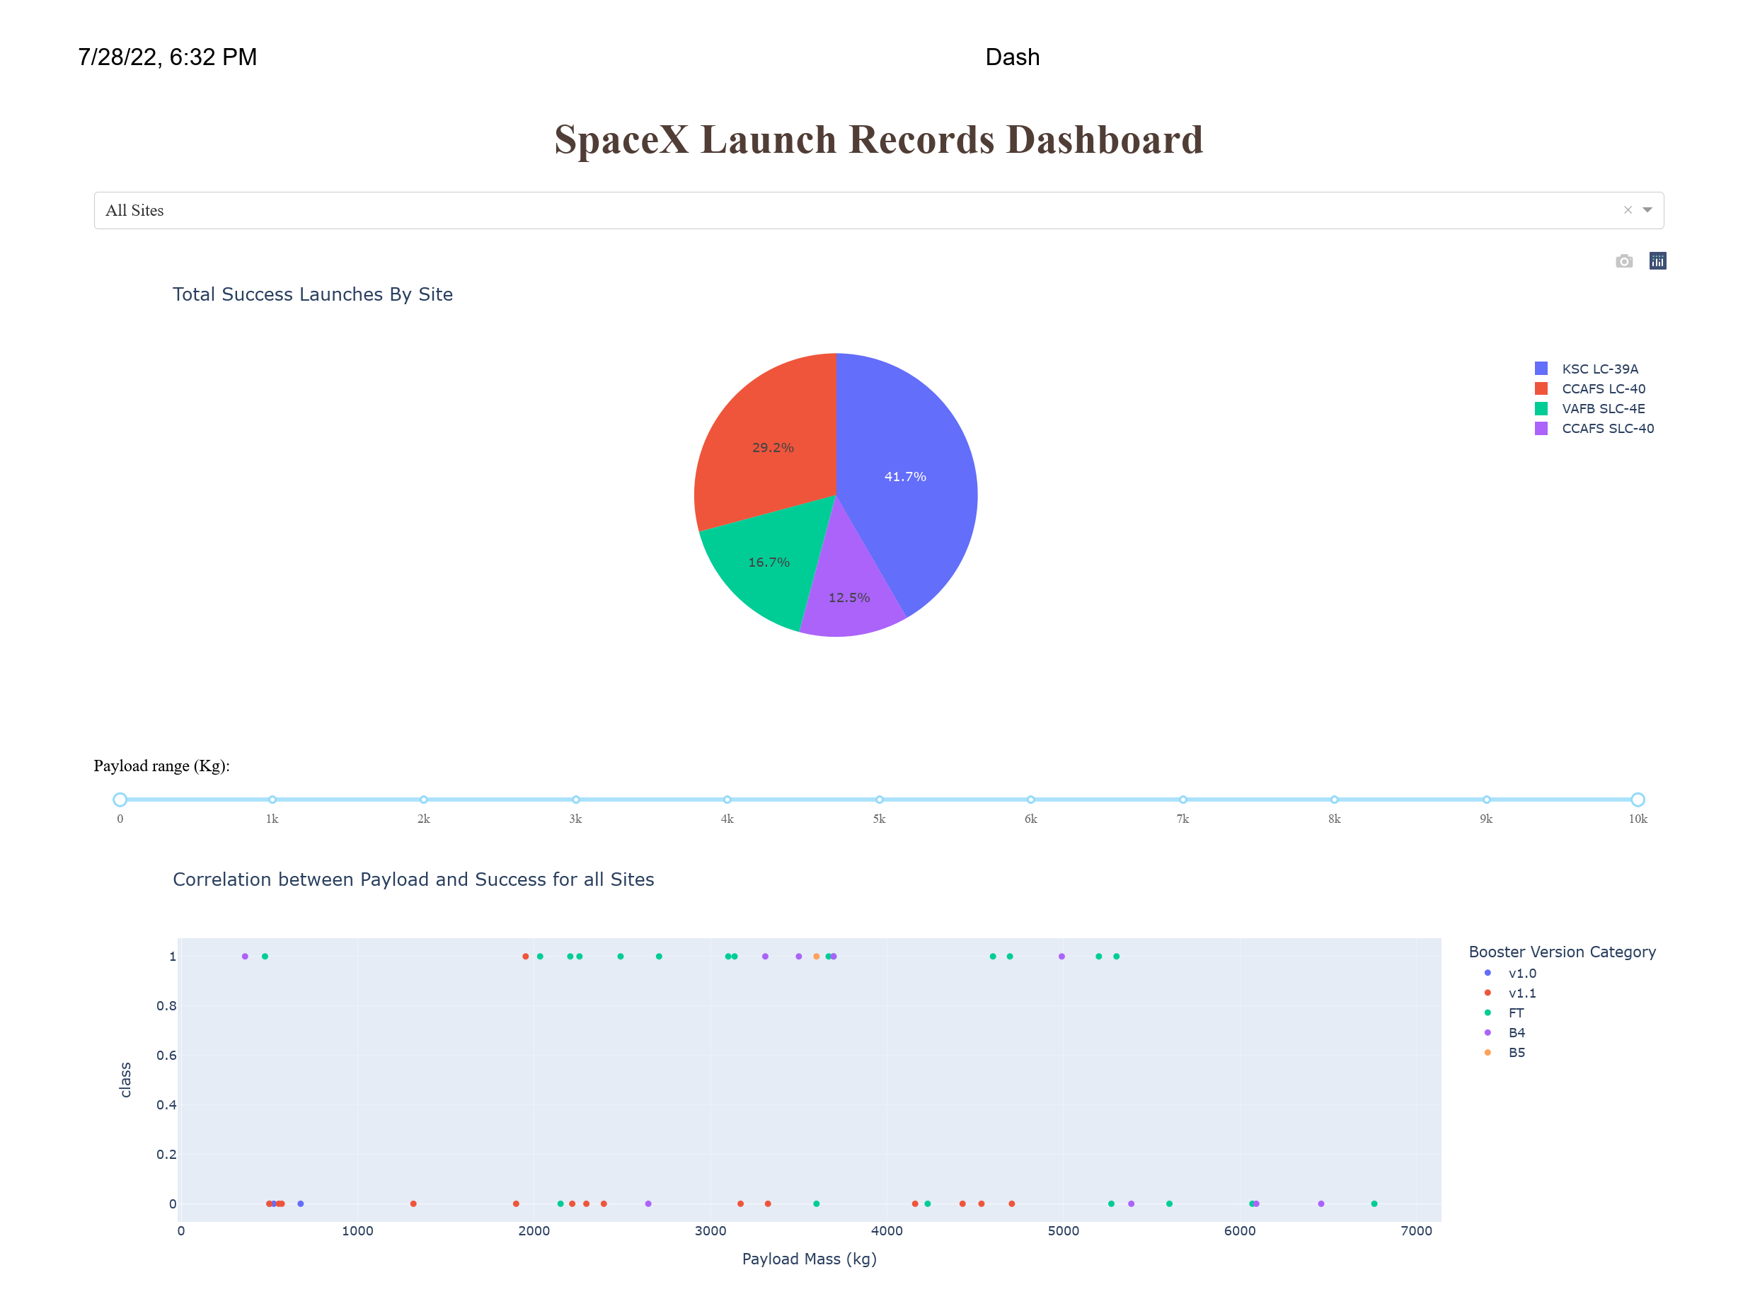
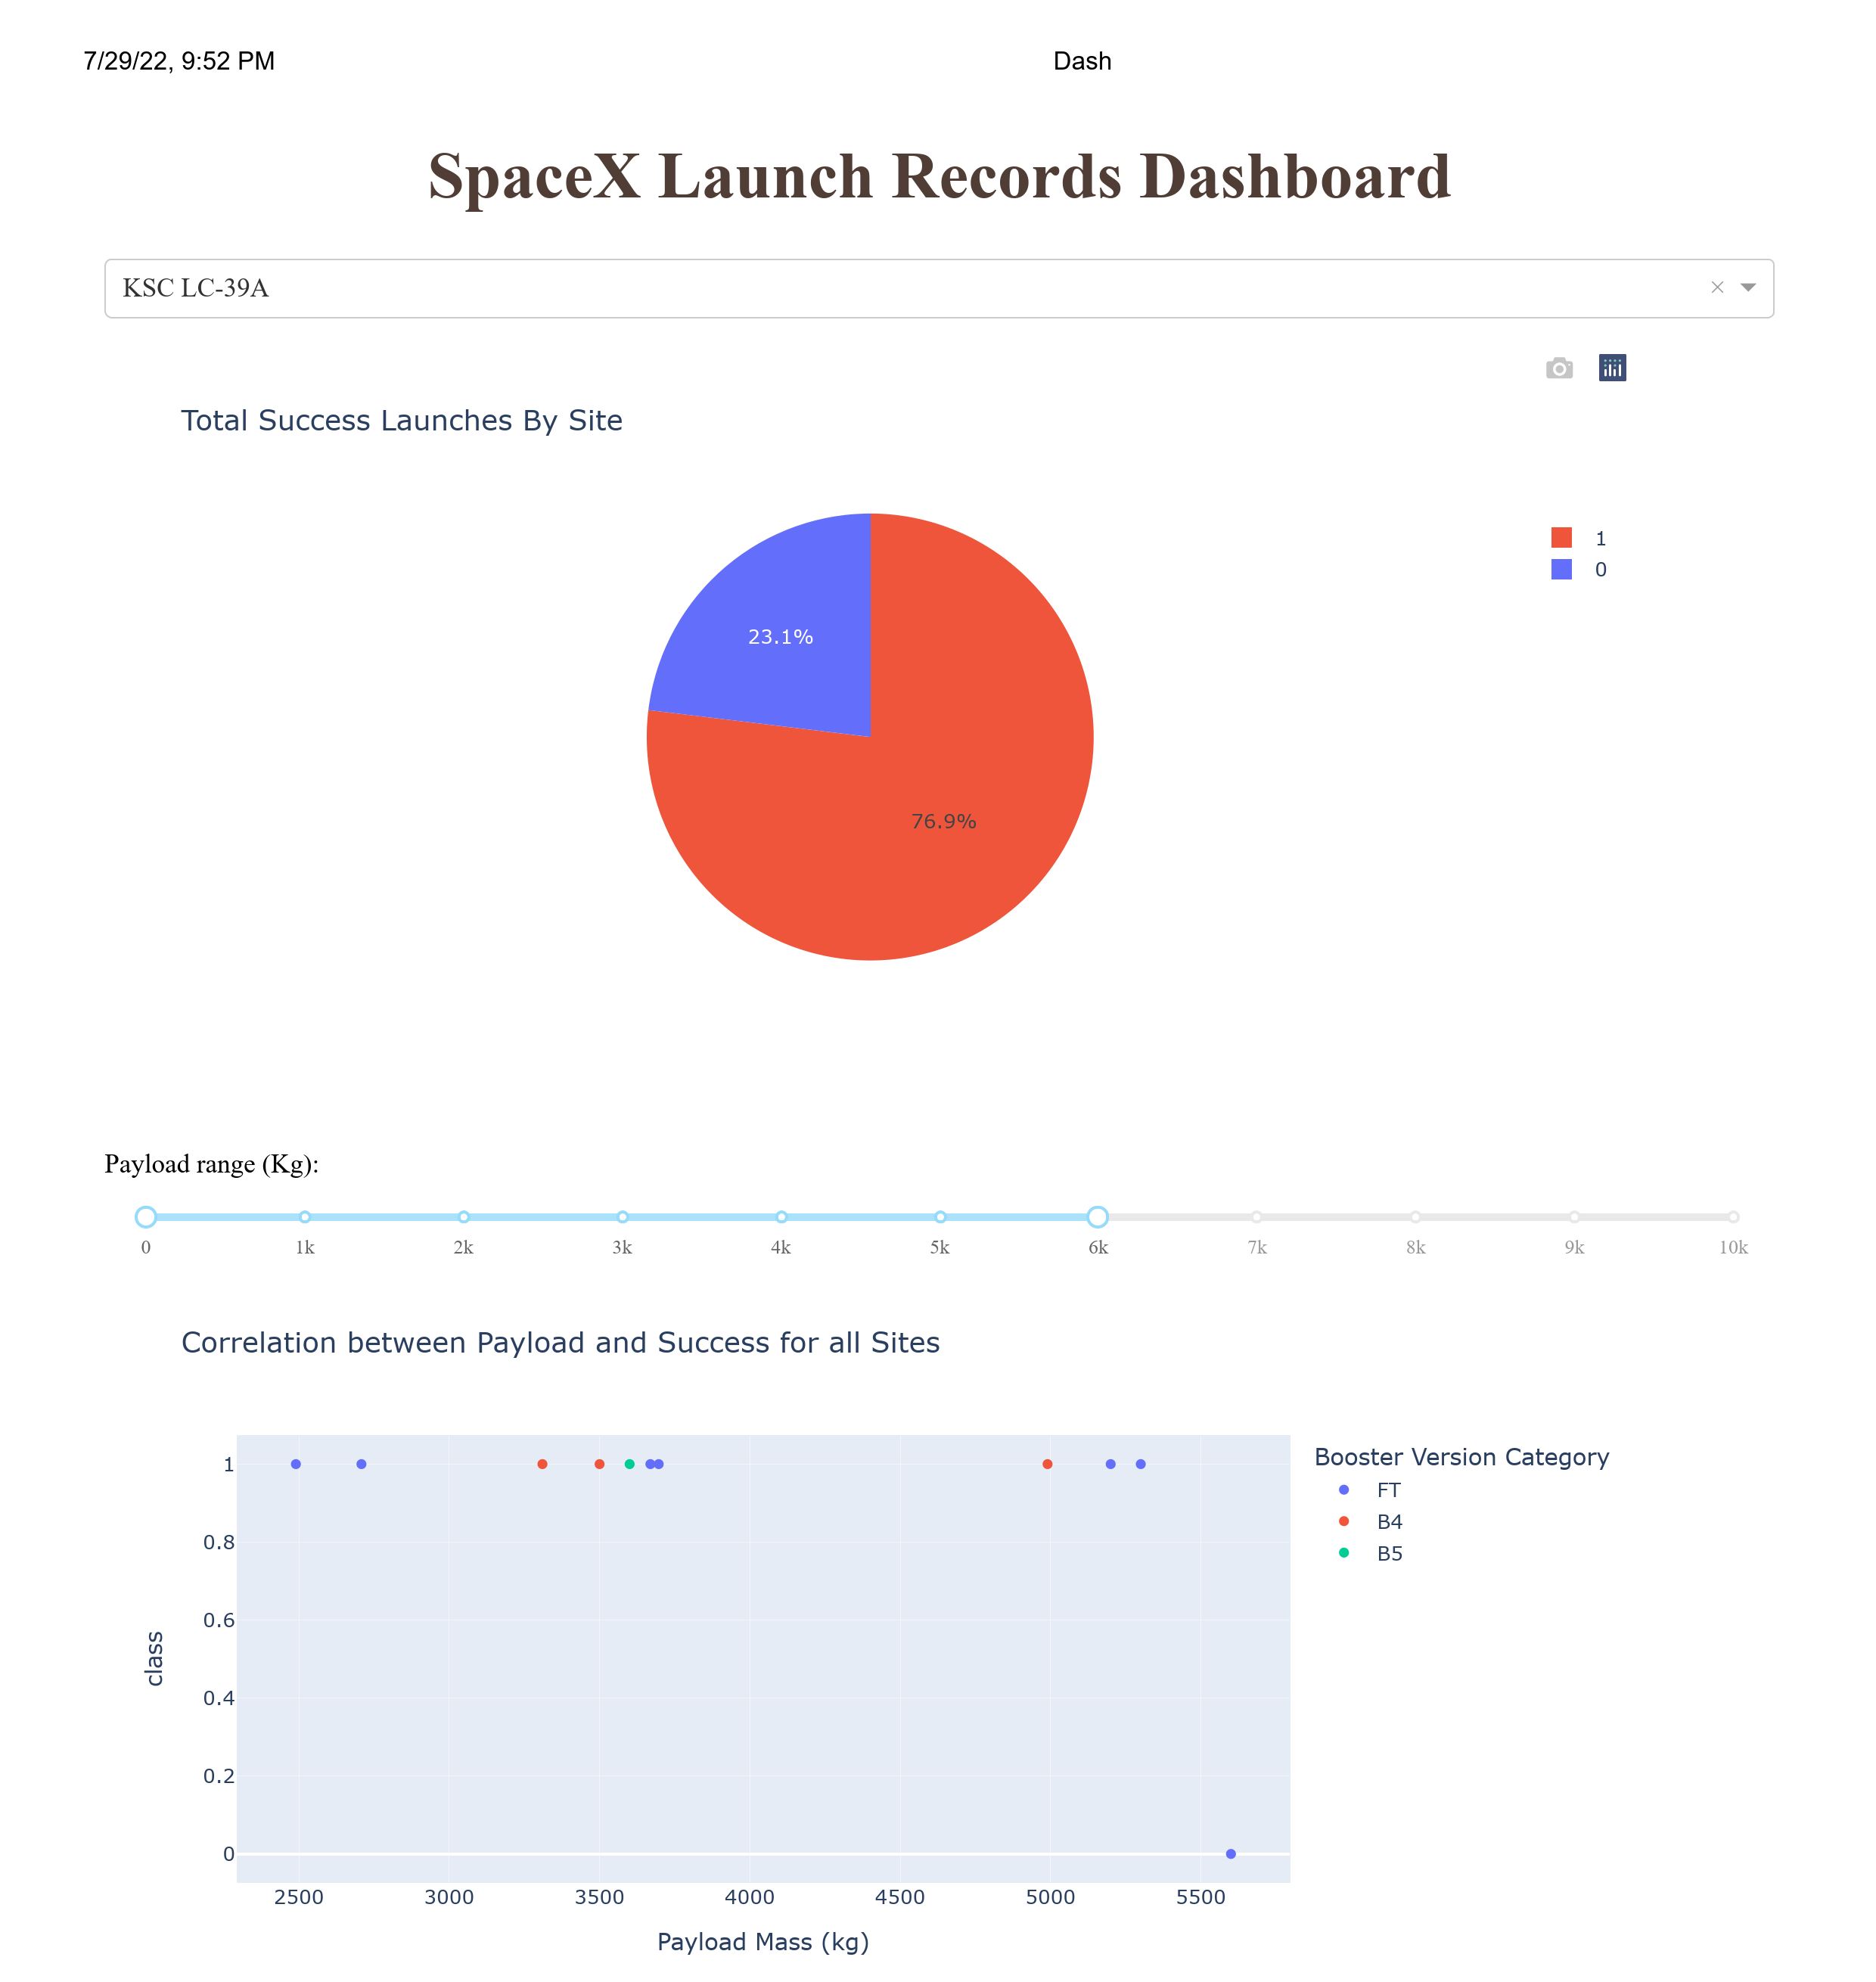
Results (Interactive Analytics)

Slide 19
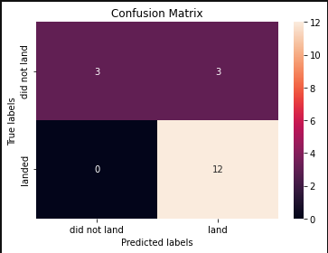
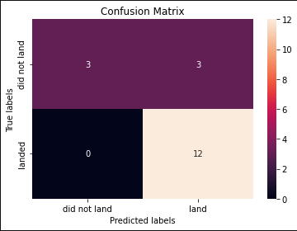
Results
Logistic Regression
Best Parameters:
C = 0.01
Accuracy Score (Test Dataset):
0.8333
Decision Tree
Best Parameters:
criterion = entropy
max_depth = 4
max_features = sqrt
splitter = random
Accuracy Score (Test Dataset):
0.8333
Support Vector Machine
Best Parameters:
C = 1.0
gamma = 0.03162277…
kernel = sigmoid
Accuracy Score (Test Dataset):
0.8333
Support Vector Machine
Best Parameters:
algorithm = auto
n_neighbors = 10
p = 1
Accuracy Score (Test Dataset):
0.8333

Slide 20

Section 2

Slide 21
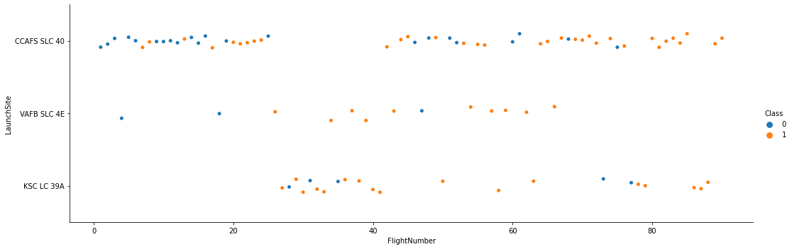
Flight Number vs. Launch Site
Flight Number and Launch Site does not have a very strong relationship with each other
There is higher success rate in recent launches (Flight Number > 80)

Slide 22
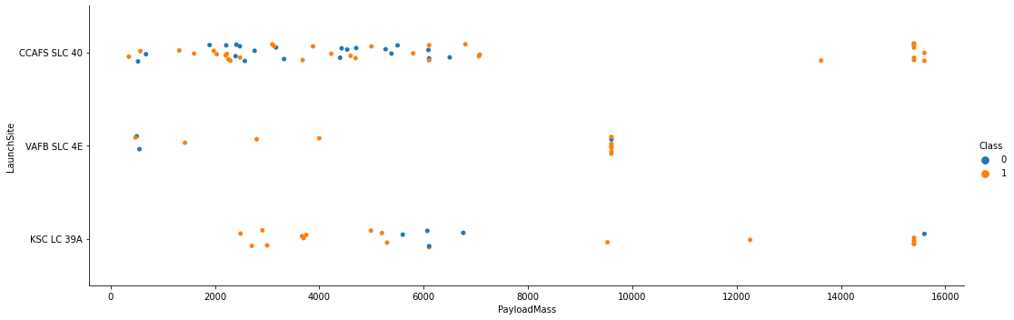
Payload vs. Launch Site
CCAFS SLC 40 has 100% success rate when payload mass > 12000
VAFB SLC 4E does not have heavy payload (> 10000)
KSC LC 39A has 100% success rate when payload mass < 5500 (approximately)

Slide 23
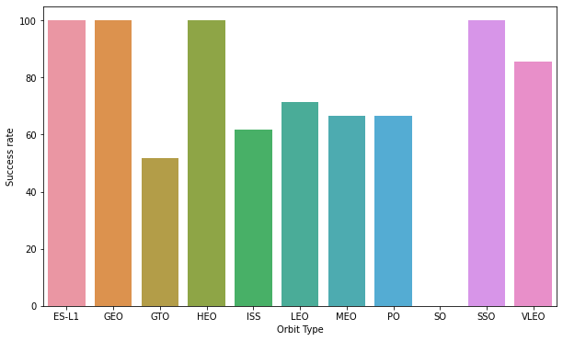
Success Rate vs. Orbit Type
ES-L1, GEO, HEO, and SSO orbit type has 100% success rate
VLEO has very high success rate (>80%)

Slide 24
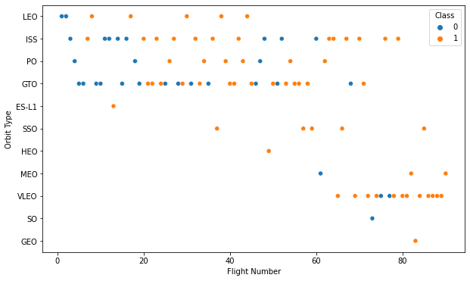
Flight Number vs. Orbit Type
LEO orbit the Success appears to increase when the number of flights increase
There seems to be no relationship between flight number when in GTO orbit
SSO orbit type has 100% success rate while the rest of orbit types with 100% successrate has only 1 launch count

Slide 25
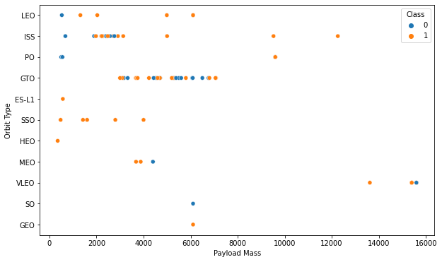
Payload vs. Orbit Type
With heavy payloads the successful landing or positive landing rate are more for Polar,LEO and ISS
For GTO we cannot distinguish this well as both positive landing rate and negative landing(unsuccessful mission) are both there

Slide 26
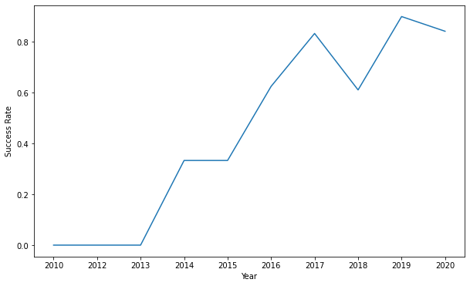
Launch Success Yearly Trend
The sucess rate since 2013 kept increasing until 2020 which shows a slight drop

Slide 27
SQL Results Notice
Please take note I conducted the lab with a local MySQL database, this is because I was unable to connect to IBM_DB2 service when using the magic command (%sql), kindly refer to the discussion section of this capstone project course if you don’t face this issue yourself to understand more about this issue
As a result, the results of the below section might be displayed in a slightly different way because I don’t know how differently MySQL behaves compared to IBM_DB2
Thanks for understanding

Slide 28
All Launch Site Names
Query:
SELECT DISTINCT(Launch_Site) FROM spacex_capstone.spacextbl;
Result:
[('CCAFS LC-40',), ('VAFB SLC-4E',), ('KSC LC-39A',), ('CCAFS SLC-40',)]
Explanation:
There are only 4 launch sites available from the dataset, CCAFS LC-40, VAFB SLC-4E, KSC LC-39A, CCAFS SLC-40

Slide 29
Launch Site Names Begin with 'CCA'
Query:
SELECT Launch_Site FROM spacex_capstone.spacextbl WHERE Launch_Site LIKE "CCA%" LIMIT 5;
Result:
[('CCAFS LC-40’,), ('CCAFS LC-40',), ('CCAFS LC-40',), ('CCAFS LC-40',), ('CCAFS LC-40',)]
Explanation:
There are only first 5 launch sites begin with “CCA” are shown above

Slide 30
Total Payload Mass
Query:
SELECT SUM(PAYLOAD_MASS__KG_) FROM spacex_capstone.spacextbl WHERE Customer = "NASA (CRS)";
Result:
[(Decimal('45596'),)]
Explanation:
The sum of all payload mass sent by “NASA (CRS)” is 45596 KG

Slide 31
Average Payload Mass by F9 v1.1
Query:
SELECT AVG(PAYLOAD_MASS__KG_) FROM spacex_capstone.spacextbl WHERE Booster_Version = "F9 v1.1";
Result:
[(Decimal('2928.4000'),)]
Explanation:
The average payload mass by “F9 v1.1” booster is 2928.40 KG

Slide 32
First Successful Ground Landing Date
Query:
SELECT MIN(`Date`),Landing_Outcome FROM spacex_capstone.spacextbl WHERE Landing_Outcome = "Success (ground pad)";
Result:
[(datetime.date(2015, 12, 22), 'Success (ground pad)')]
Explanation:
The first successful ground landing date is 2015-15-22

Slide 33
Successful Drone Ship Landing with Payload between 4000 and 6000
Query:
SELECT Booster_Version FROM spacex_capstone.spacextbl WHERE Landing_Outcome = 'Success (drone ship)' AND PAYLOAD_MASS__KG_ BETWEEN 4000 AND 6000;
Result:
[('F9 FT B1022',), ('F9 FT B1026',), ('F9 FT B1021.2',), ('F9 FT B1031.2',)]
Explanation:
The 4 boosters with successful drone ship landing with payload between 4000 and 6000 kg are shown above

Slide 34
Total Number of Successful and Failure Mission Outcomes
Query:
SELECT Mission_Outcome,COUNT(Mission_Outcome) FROM spacex_capstone.spacextbl GROUP BY Mission_Outcome;
Result:
[('Success', 98), ('Failure (in flight)', 1), ('Success (payload status unclear)', 1), ('Success ', 1)]
Explanation:
There are 100 successful mission and 1 failed mission outcomes

Slide 35
Boosters Carried Maximum Payload
Query:
SELECT Booster_Version,PAYLOAD_MASS__KG_ FROM spacex_capstone.spacextbl WHERE PAYLOAD_MASS__KG_ = (SELECT MAX(PAYLOAD_MASS__KG_) FROM spacex_capstone.spacextbl);
Result:
[('F9 B5 B1048.4', 15600), ('F9 B5 B1049.4', 15600), ('F9 B5 B1051.3', 15600), ('F9 B5 B1056.4', 15600) ('F9 B5 B1048.5', 15600), ('F9 B5 B1051.4', 15600), ('F9 B5 B1049.5', 15600), ('F9 B5 B1060.2 ', 15600), ('F9 B5 B1058.3 ', 15600), ('F9 B5 B1051.6', 15600), ('F9 B5 B1060.3', 15600), ('F9 B5 B1049.7 ', 15600)]
Explanation:
The names of the boosters carried maximum payload are shown above

Slide 36
2015 Launch Records
Query:
SELECT Landing_Outcome,Booster_Version,Launch_Site FROM spacex_capstone.spacextbl WHERE Landing_Outcome LIKE "%drone%" AND Landing_Outcome LIKE "%Fail%" AND YEAR(`Date`) = 2015;
Result:
[('Failure (drone ship)', 'F9 v1.1 B1012', 'CCAFS LC-40’), ('Failure (drone ship)', 'F9 v1.1 B1015', 'CCAFS LC-40')]
Explanation:
The failed landing outcome details are shown above

Slide 37
Rank Landing Outcomes Between 2010-06-04 and 2017-03-20
Query:
SELECT Landing_Outcome,COUNT(Landing_Outcome) FROM spacex_capstone.spacextbl WHERE `Date` BETWEEN '2010-06-04' AND '2017-03-20’ GROUP BY Landing_Outcome ORDER BY COUNT(Landing_Outcome) DESC;
Result:
[('No attempt', 10), ('Failure (drone ship)', 5), ('Success (drone ship)', 5), ('Controlled (ocean)', 3), ('Success (ground pad)', 3), ('Failure (parachute)', 2), ('Uncontrolled (ocean)', 2), ('Precluded (drone ship)', 1)]
Explanation:
The ranking of landing outcomes between 2010-06-04 and 2017-03-20 are shown above

Slide 38

Section 3

Slide 39
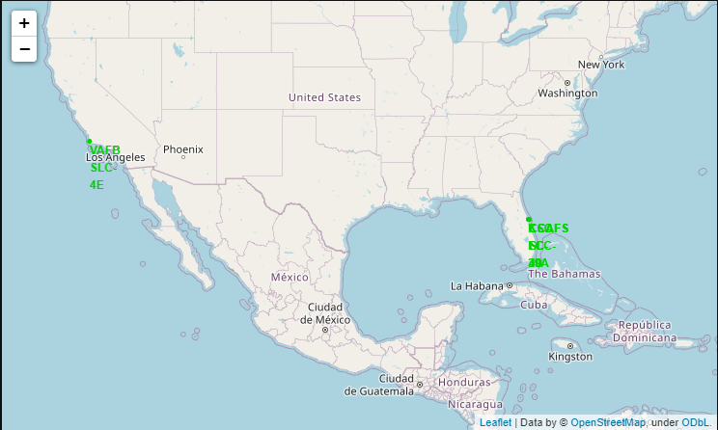
Launch Sites Location
All launch sites are located nearby coastline
All launch sites are located at around 30 degree north from equator

Slide 40
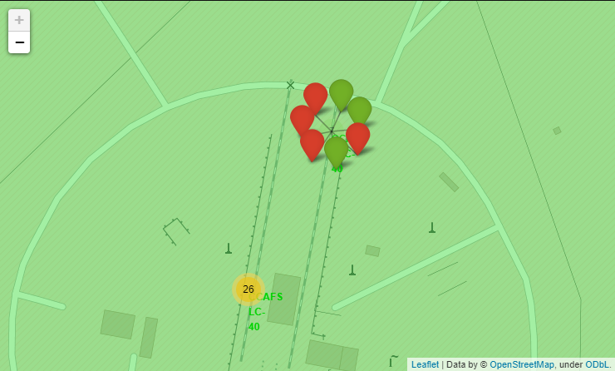
Landing Outcome of Launches in Each Site
The number 26 and 7 are the clusters of launch markers at each site
Green marker represents successful launch outcome
Red marker represents unsuccessful launch outcome
NOTE: There is an issue with folium unable to load the icon on each marker, please do understand this is the reason why the icons are not displayed properly

Slide 41
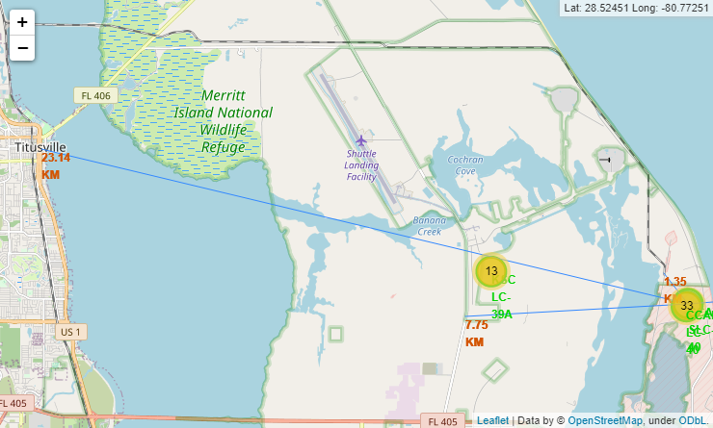
Distances to nearest attractions
The line display the direction and distance from the launch site to the nearest attractions
The text in red display the distance from the launch site to the nearest attractions
City (Titusville): 23.14 KM
Highway: 7.75 KM
Railway: 1.35 KM

Slide 42

Section 4

Slide 43
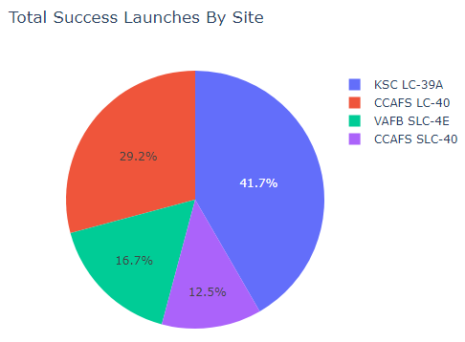
Total Success Launches By Site
KSC LC-39A has the highest number of successful launches
CCAFS SLC-40 has the lowest number of successful launches

Slide 44
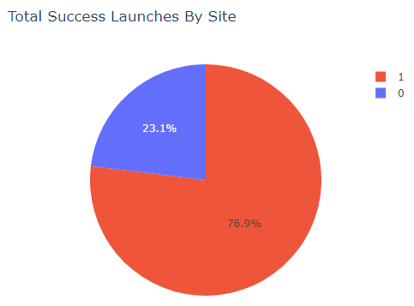
KSC LC-39A Launches
KSC LC-39A has 76.9% successful launch (10 out of 13 launches)
KSC LC-39A has only 23.1% successful launch (3 out of 13 launches)

Slide 45
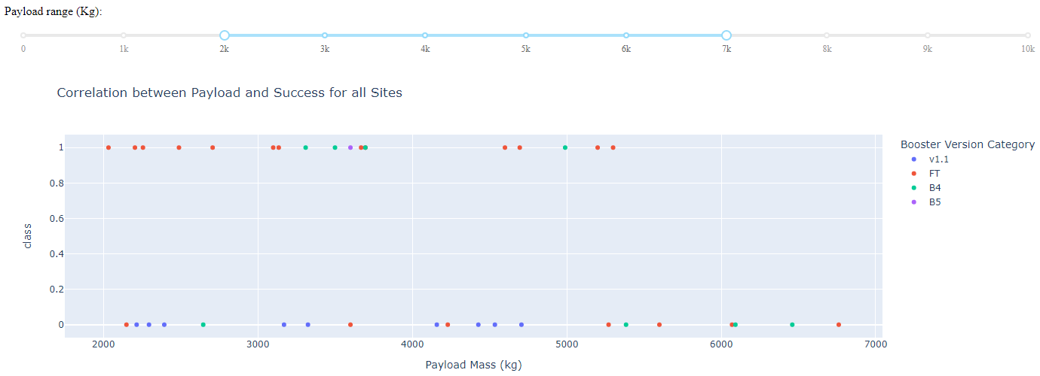
Correlation between Payload and Success for all Sites
Payload between 2000 to 5500 has highest success rate
FT booster has highest success rate out of all booster versions

Slide 46

Section 5

Slide 47
Classification Accuracy
All 4 classification models show the same accuracy score after using GridSearchCV to determine the best parameters
While decision tree has the highest accuracy score 0.875 with the training dataset

Slide 48
Confusion Matrix
This model performs the best at predicting True Positive
While it did predict all 3 True Negative correctly, but given the small number of prediction (only 3), we can’t make much conclusion from it
This model also performs worst in False Positive, there are 3 cases where it predicted to be successful launch but in fact they were not

Slide 49
Conclusions
The best suited classification model in addressing this problem is decision tree model with accuracy as high as 83.3333%

Slide 50
EXTRA (Innovation Section)
I was trying to combine all 4 models together since all 4 models has 83.3333% of accuracy score with the test dataset, so I can't actually judge easily which is the best model to use, so why not use all and see if it actually gives any improvement?
The concept is if 3 out of the 4 models predicted the same outcome, then we will take that outcome as the predicted outcome
If only 2 out of the 4 models predicted the same outcome, then we will take it as successful launch prediction
So I did a test on getting all yhat from the test_x datasets and compare all 4 yhat together and see if they are different from each other, and only if they differ from each other, this approach is doable
It turns out that all 4 yhats equals each other, that means all 4 models predicted exactly the same using the test_x dataset
This renders me no point continue trying to combine all 4 models into one because the combined model would have given the exact same predictions as any one of the model

Slide 51
Appendix
Github Repository: https://github.com/pi31416chan/Coursera-Applied-Data-Science-Capstone

Slide 52


